Slide 1

Fast Hardware Prototyping for Wearable Devices
By
Cyrill Lippuner
Responsible:
Prof. Dario Floreano
Matteo Machini
Olexandr Gudozhnik
Notes:
Hello everybody
Today I want to present to you a Plug‘n‘Play Framework enabling fast prototyping as a middleware between the physical devices and the computer tools for data analysis.

Slide 2
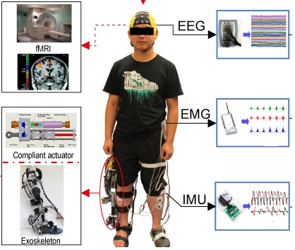
Problem
Unusally, data is not needed by the people developing the aquisition software
Large variety of different sensors, protocols and standards
Notes:
People often face the problem while working on project in various domains, that they need to analyse data coming from a large range of sources. Those people are usually no software engineers or trained in embedded systems. Therefore a lot of time is lost to those tasks and one looks for easy-to-use applications and the first coming to your mind is probably Arduino.

Slide 3
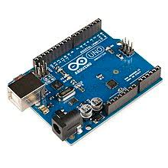

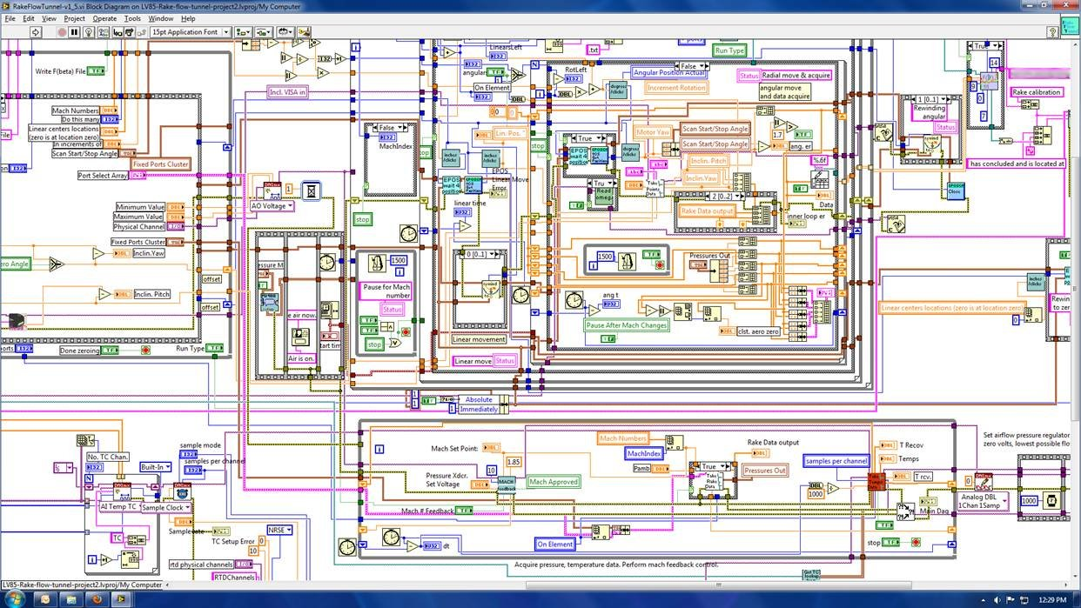
State Of The Art
Arduino
Dedicated drivers are not always available
Hardware/Software limited
Protrietary programming language
ROS
Quite complex
Linux only
LabView
Complex visual based framework
Expensive ($1.325 / licence)
Notes:
But Arduino has some major downsides. It has a unique programming language and one depends on drivers for the sensors which need to be imported. Further it is rather slow in processing information, resulting in a strong limitation on hardware and software side.
Another widely used framework is ROS, quite complex to start with even for basic projects and it is linux only.
Last but not least there is LabView, and I think the image says everything. It is a complex visual based framework all-in-one solution providing hardware and software. It is a strong industrial standard but has also high costs.

Slide 4
Proposed Solution
«Integration of hardware and UI for a new framework»
CSV
IMU
I²C
Storage
Black Box Framework
EMG
Analog
f(t)
Data Plots
SPI
Stream
…
t
3rd-Party Software
Notes:
Therefore the goal of this semester project is to propose a solution containing the hardware communication channels like I2C, SPI and basic analog inputs – automatically scanning, recognizing and identifying devices –interfacing them by dedicated device drivers – communication via Wifi to a computer with a graphical user interface – providing an overview of the current devices connected, a live plot for each device and settings to configure the devices. It is also able to stream the incoming data to a file for data analysis or directly via UDP to third-party software.

Slide 5
Work Plan
NOW
Communication
Drivers
APIs
Hardware Case
Notes:
I did not start from scratch as last semester there was already another student developing the base for this framework. He did an evaluation of a set of different microcontroller and developed a basic firmware to proof the concept. He also proposed identification methods for different devices that can be plugged into the black box.
But from that state to an autonomous Plug‘n‘Play Framework was still a long way to go.
I started by setting up the communication channel between the microcontroller and the computer followed by implementing a set of drivers for different devices proving the concept. API‘s are provided to access the data stream by directly listening to the communication channel or letting the interface stream.
The last step is a hardware case of the framwork enabling plug‘n‘play functionality and an easy usage.

Slide 6
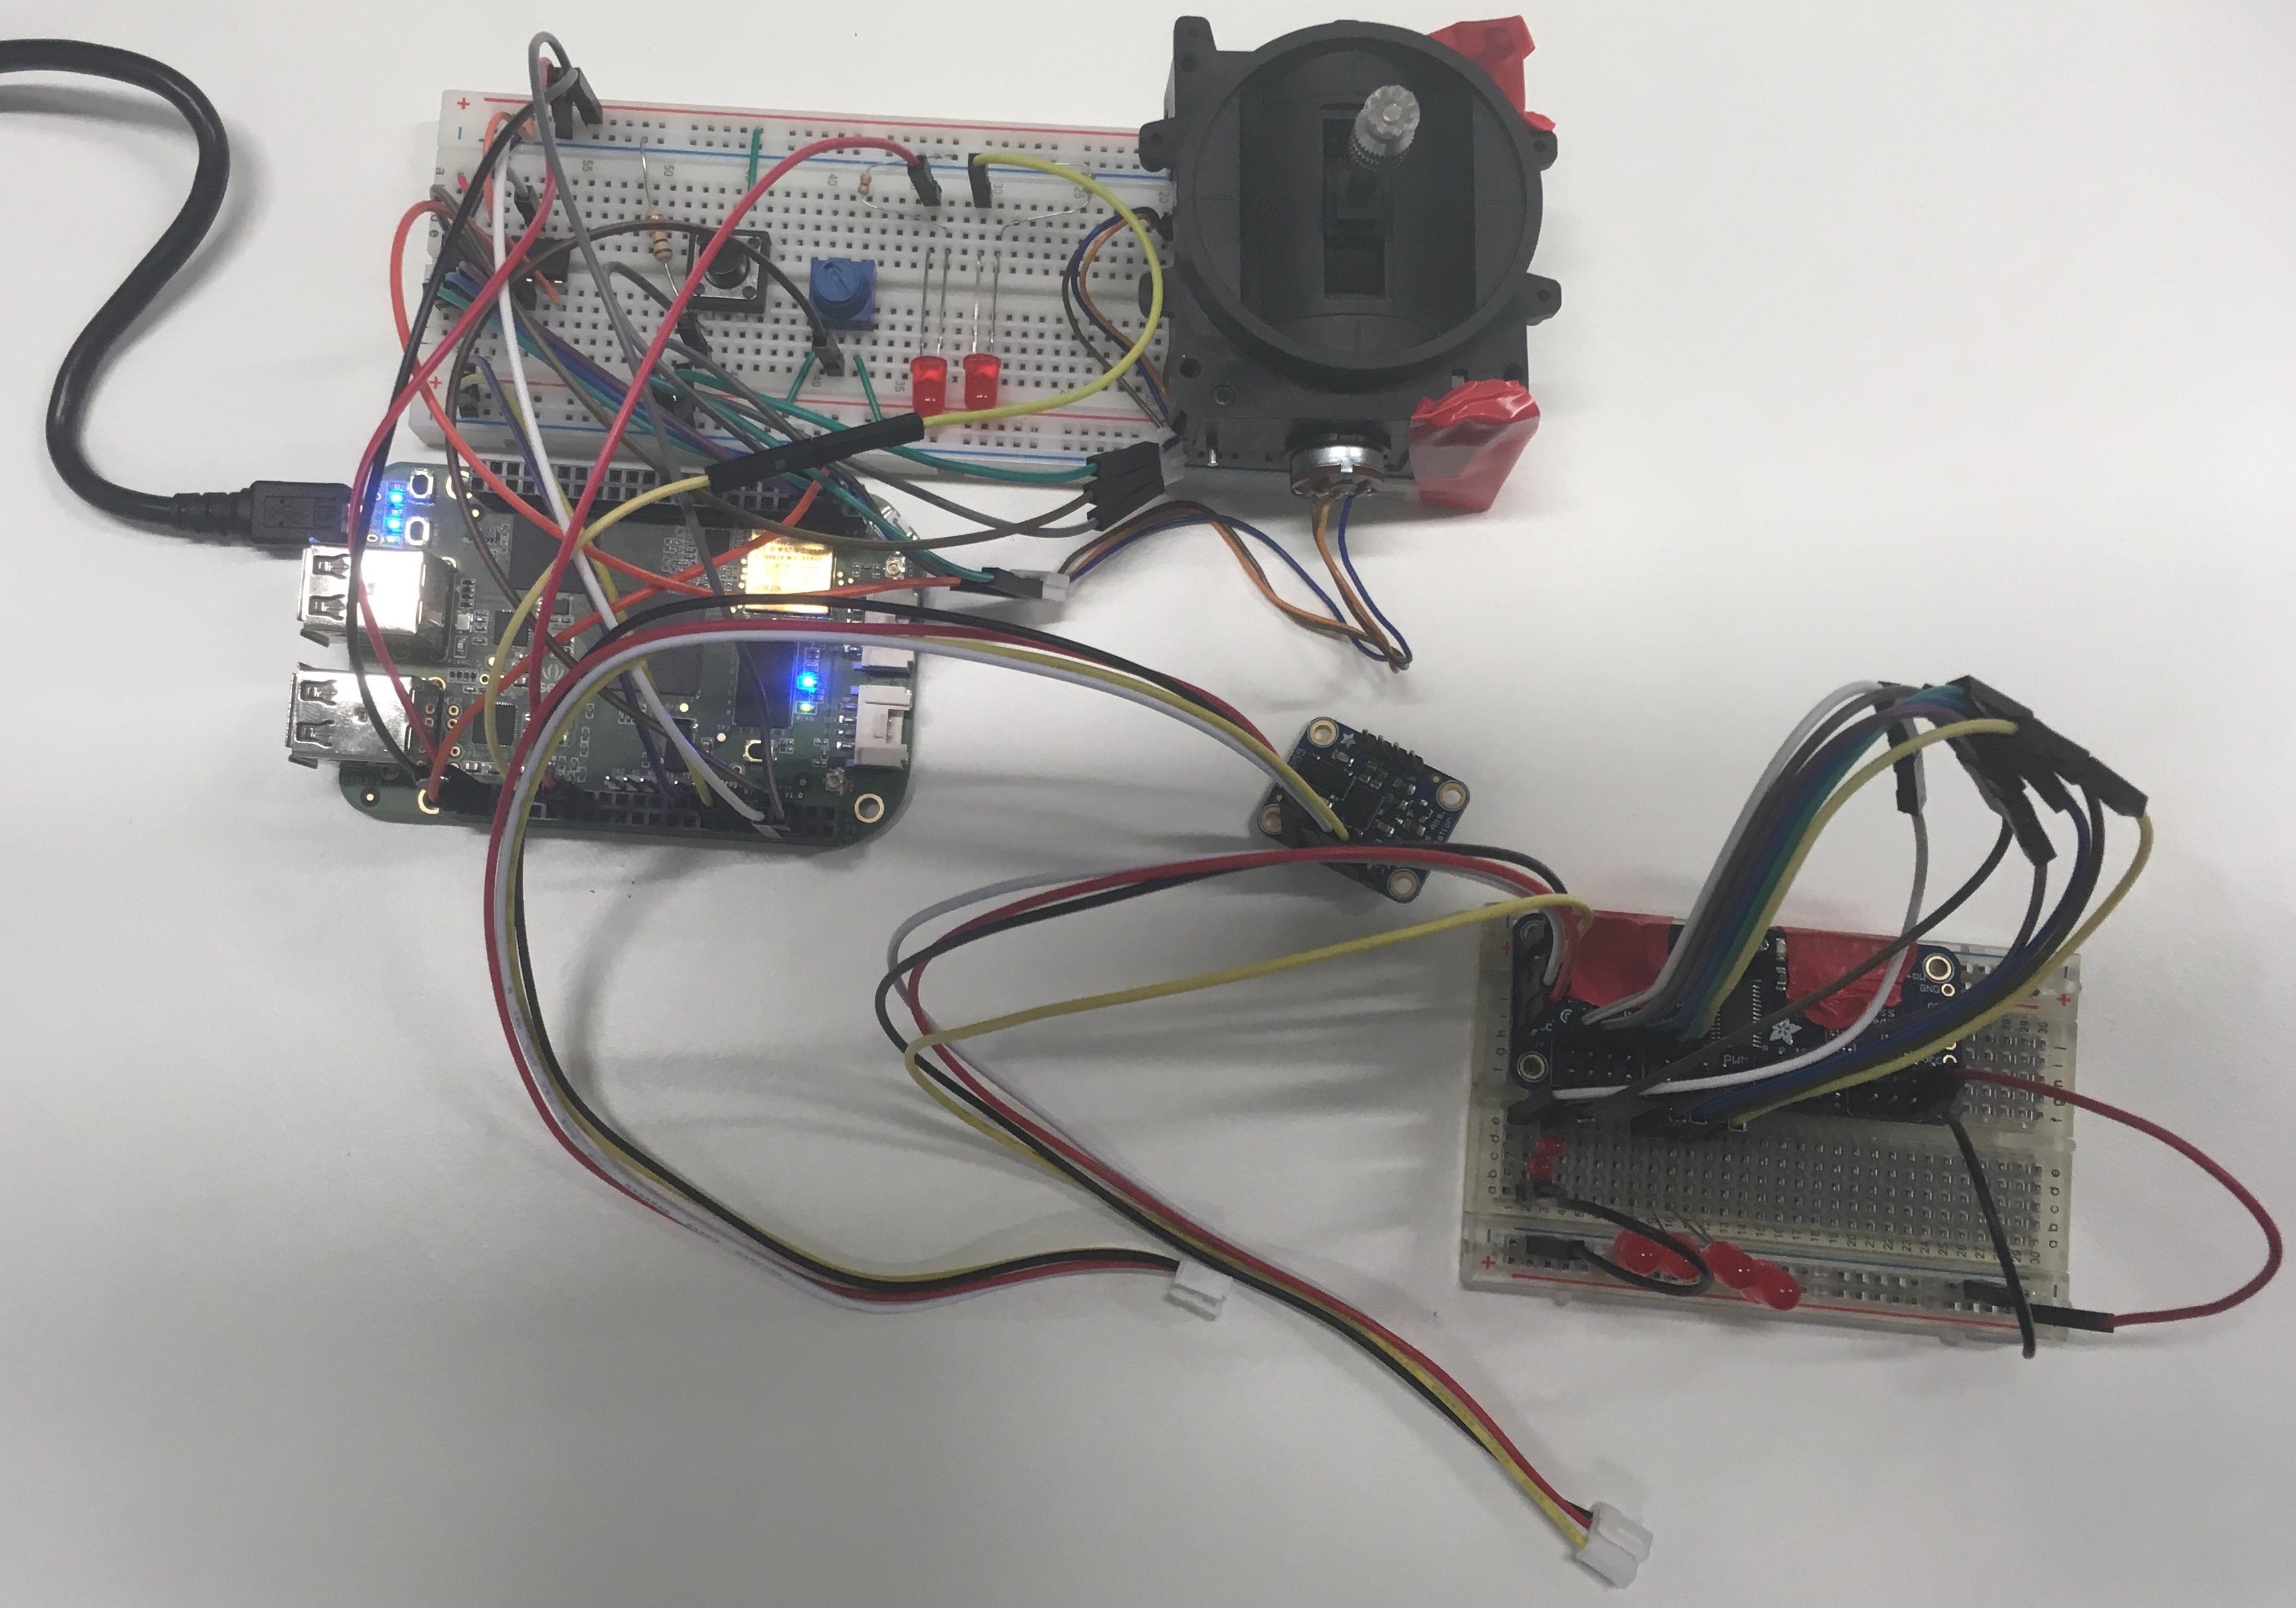
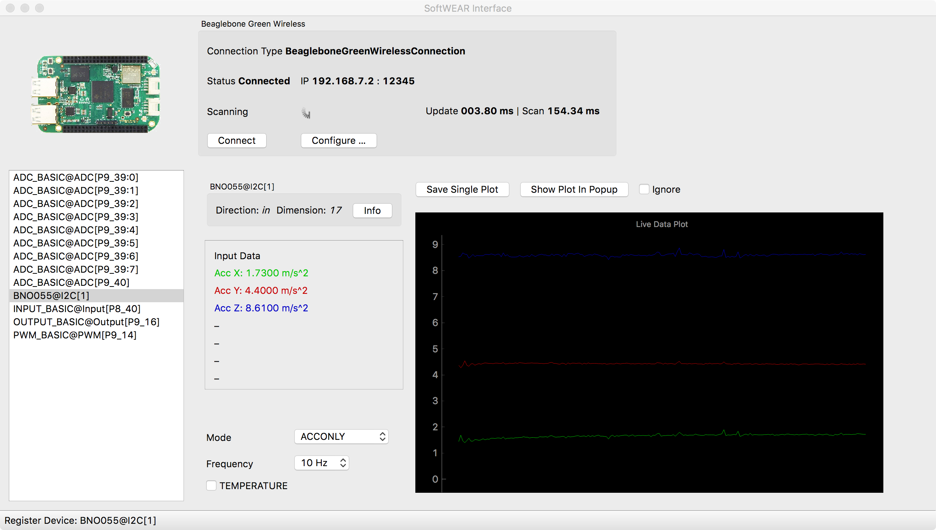
What is done – Demo
Digital IN
Analog IN
Analog MUX IN
Analog MUX
Digital OUT
PWM OUT
Stream
Controller
Data
IMU
Device List
Live Plot
16-PWM-Driver
Settings
Notes:
Here you see the current state of the project with the hardware setup and the graphical user interface which I will demonstrate on the real example.

Slide 7
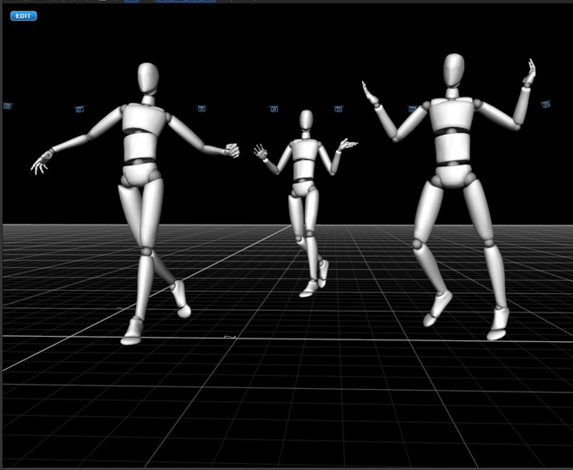
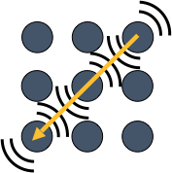
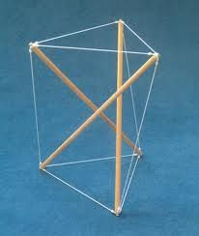
Projects benefitting from This framework
Development and test of a human motion capture system
Victor Camille Baptiste Faraut
(9x IMUs)
Haptic display for a wearable Human-Robot Interface
Hugo Kohli
(9x PWM)
Give the sense of touch to soft modular robots
Siqi Zheng
(6x ADC)

Slide 8
Future Work?
Plug‘n‘Play
Versatile Hardware Connectivity and Case
Notes:
The microcontroller will be placed inside a case with different connectors for the devies. An instruction manuel for end users needs to be written as well as a documentation for software and hardware maintaining. For example if one wants to implement drivers for a new type of devices, there will be a tutorial how to do it.

Slide 9
Questions?
Notes:
Thank you for your attention and I am happy to answer your questions.

Slide 10
Appendix
Notes:
Thank you for your attention and I am happy to answer your questions.

Slide 11
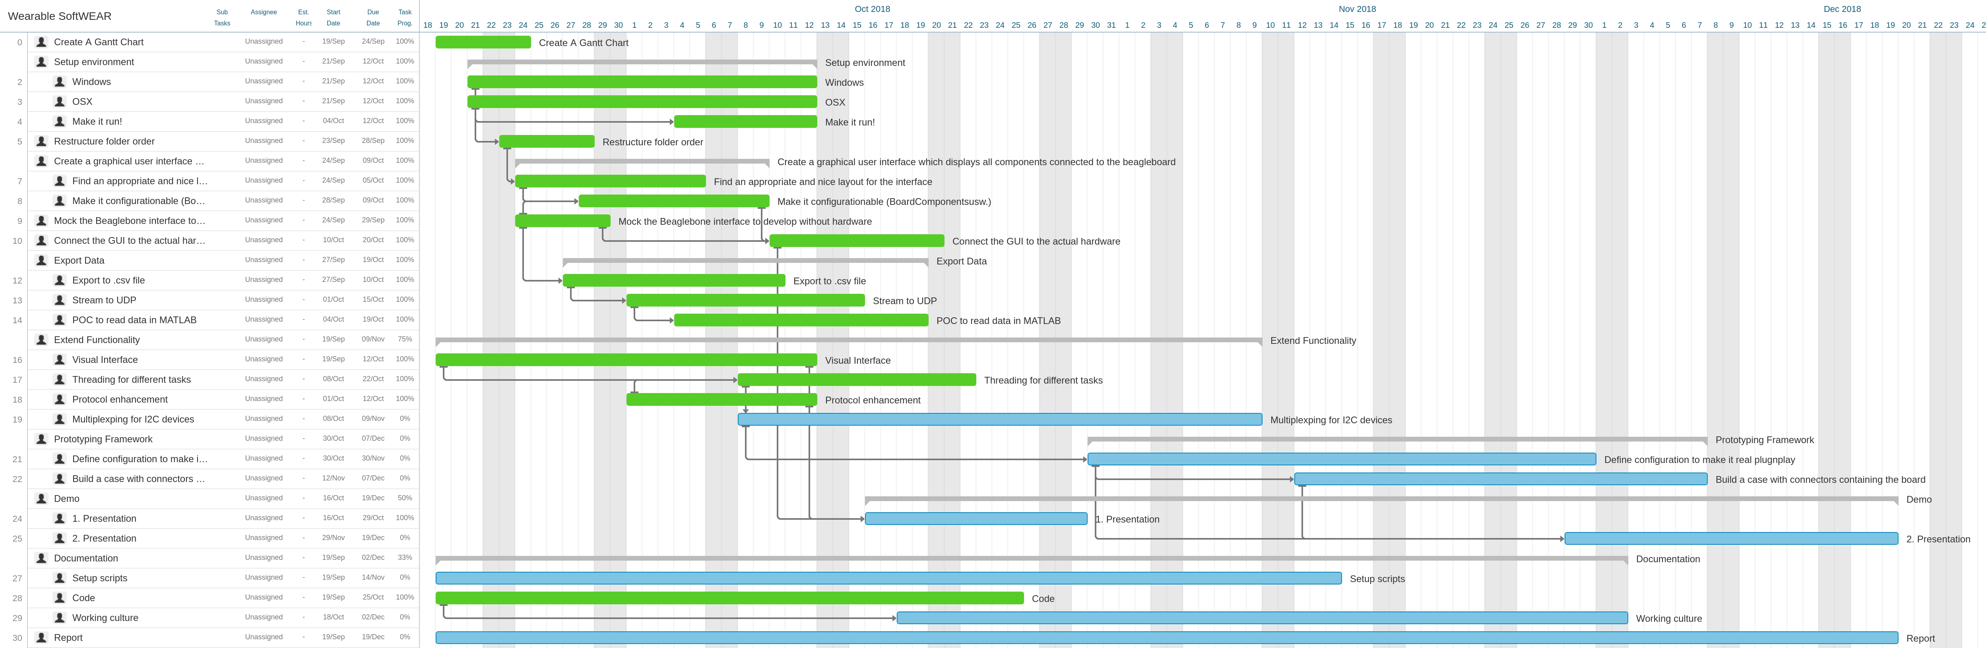
GANTT
Notes:
A major part of the firmware and the interface with the GUI is done. One is able to plug a device and get it listed in the GUI along its data plot and available settings.

Slide 12
Devices
Device Drivers
Modules
Interface
Applications
Device Driver A
I²C
I²C
Device Driver B
I²C
Device Driver C
Digital I/O
IN
Device Driver D
Communication Module
TCP/IP
Communication Module
GUI
OUT
Analog IN
Device Driver E
ADC
Driver Module
MAIN
PWM
Device Driver F
PWM
Comm.
SPI
Device Driver G
SPI
UART
Device Driver H
CSV
UART
Definitions
MUX Drivers
MUX Module
Board Configuration
MUX Driver A
I²C
MUX Driver B
Hardware
ADC
Firmware
Software
Notes:
The architecture of the framwork can be diveded in 3 separate parts.
The black box will expose connectors for the different devices which are managed by the devices drivers. Each device driver has a separate thread to communicate with the devices. The set of drivers is managed by the driver module which will constantly collect new data from the drives, test device connections and scan for new devices. If a channel is multiplexed, the Mux drivers are used to switch between the different channels. The main module takes care of the data thread by sending and receiving messages via the communication module to the interface. The interface the passes the data to different Applications like the inbuilt GUI, thir-party software or streams it to a file.

